Slide 1

Jean-Claude’s London Restaurant
Selecting a location

Slide 2
Selecting for success
The enduring survival of restaurants is a function of:
Acceptable service
Acceptable price-point
Acceptable quality of meals
Sufficient number of clientele
Clientele is mostly outside the owner’s control after opening
Restauranteurs must either:
Choose service-level, price-point, menu and move to find sufficient clientele
Choose location and adapt the other factors to suit

Slide 3
French restaurants in London
Jean-Claude’s experience of opening speciality French restaurants is that these factors dictate their success:
Presence of other restaurants: people tend to travel to particular areas to eat, so being co-located with other restaurants may bring passing trade.
Absence of direct competition: restaurants established with nearby direct competition for the same clientele, suffer from the competition.
Wealth of clientele: French cuisine is associated with sophisticated service and fine food, which tends to result in higher prices that only wealthier people can afford. Success therefore is related to nearby wealth.

Slide 4

Data acquisition and cleaning
London population data from Doogal dataset:
323,306 rows and 49 features in raw data
Each row represents a London postcode: up to about 100 homes each
Example features: Income, household size, population, other
Features with little relevance (e.g. local water company) dropped
London venue data from FourSquare:
25,658 rows and 11 features in raw data
Each row represents a venue such as restaurants, shops and attractions
Example features: location, category

Slide 5
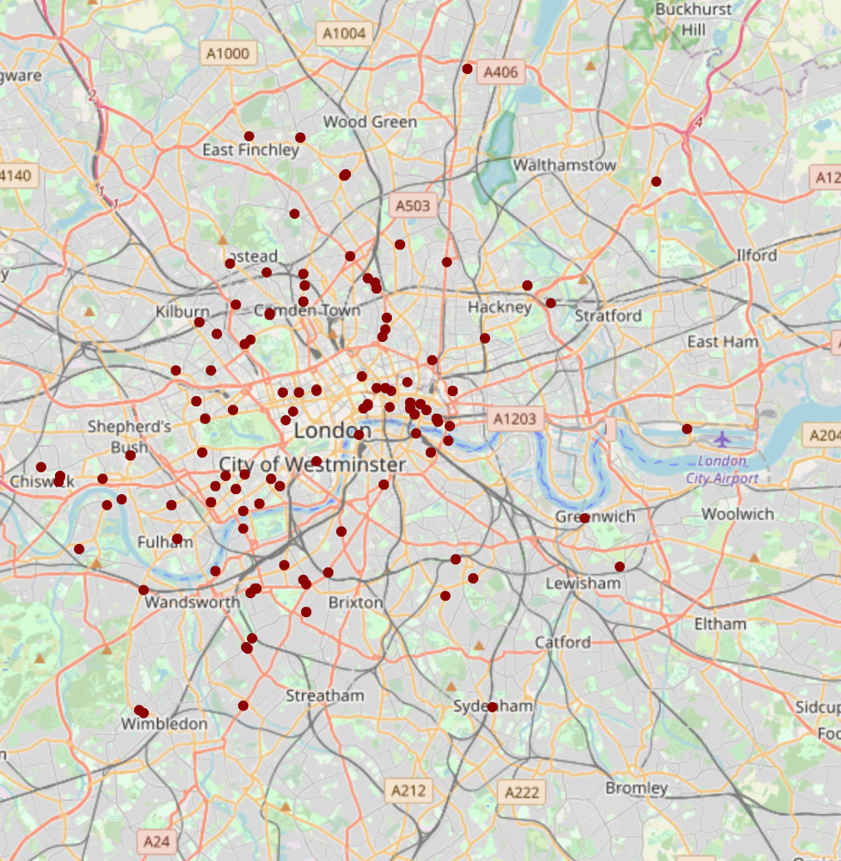
Existing restaurant locations
Densely clustered in centre
Remainder largely in wealthier West and North London

Slide 6
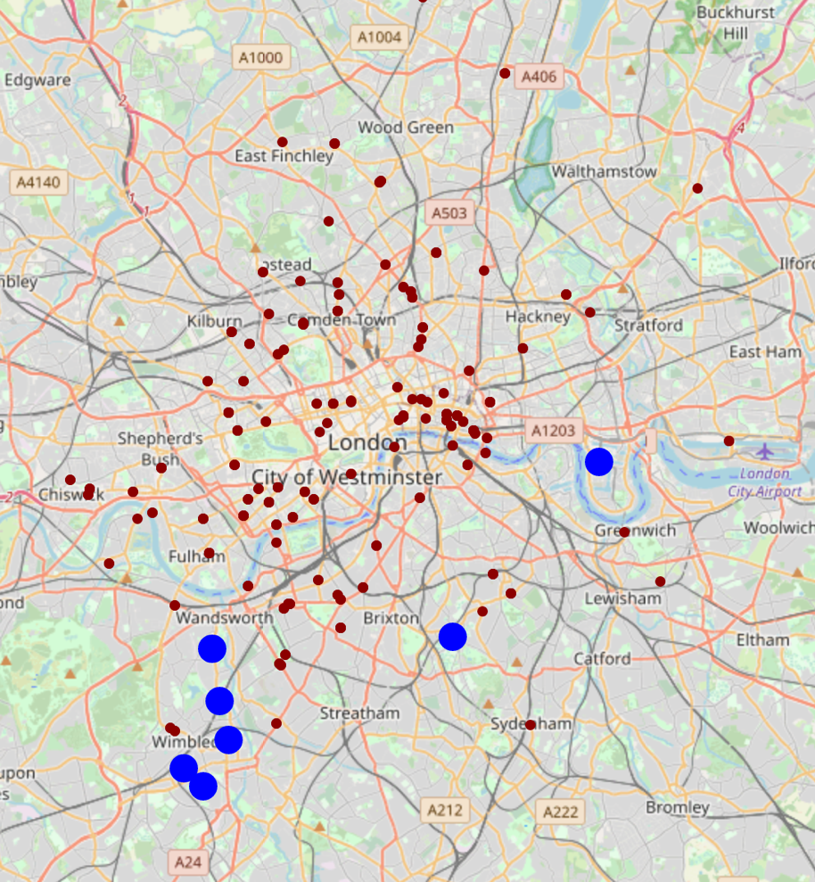
Analysis 1: Jean-Claude
Gaps in the market?
Jean-Claude’s method identifies wealthy areas with restaurants but no direct competition for diners seeking French cuisine.
South-West London and ‘The City’ both expensive

Slide 7
Analysis 1 Recommendations
Canary Wharf
Wimbledone Park
Dulwich Village
Merton Park
Dundonald
Southfields
Trinity

Slide 8
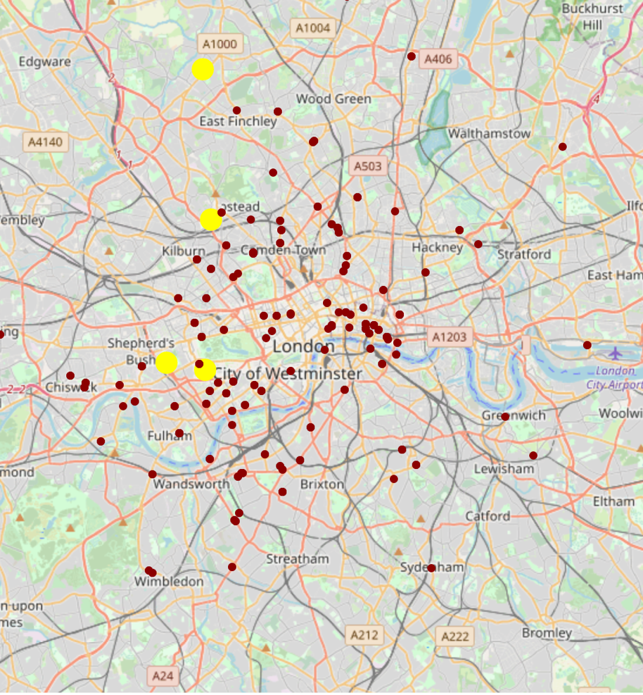
Analysis 2: K-Means
K-Means analysis provides areas that characteristically support French restaurants but might support more than presently exist
North-West London upmarket but less expensive

Slide 9
Analysis 2 Recommendations
West Finchley (North)
Frognal and Fitzjohns (North)
Holland (West)
Queen's Gate (West)

Slide 10
Conclusion and Recommendations
Overall profitability might be improved by avoiding the expensive areas of London
Further exploration of North-West London, in particular:
Frognal and Fitzjohns: Some existing French restaurants but should have local support for more
West Finchley: No existing French restaurants but should have local support for one

